Slide 1

Clustering Acute Myeloid Leukemia Patients with Cancer Cell Line Based on Mutational Profile
Billy Wilkerson
Image taken from newatlas.com

Slide 2
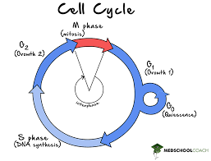
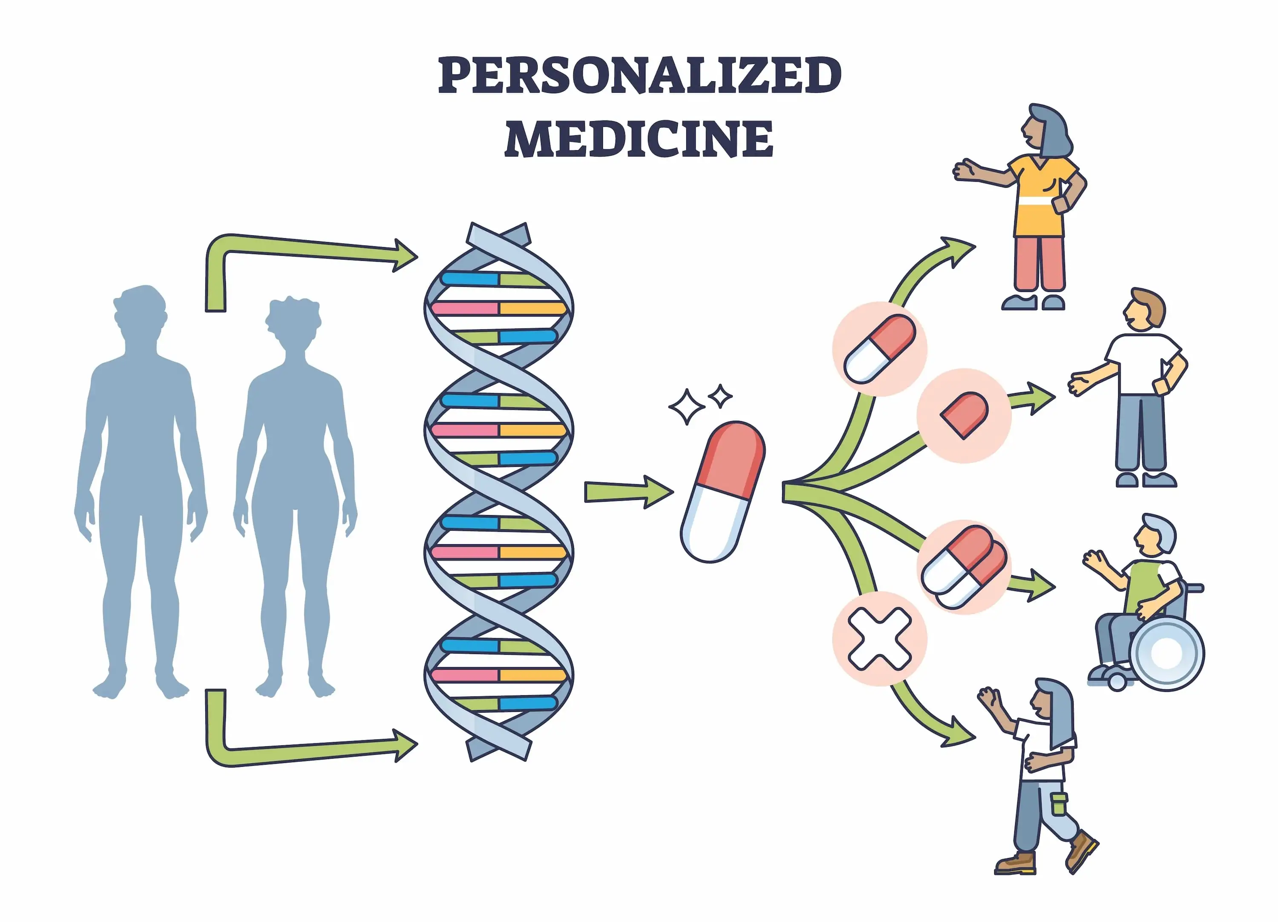
What Is Cancer?
Affects 1 in 3 people in the US
Many different diseases defined by uncontrolled cell growth
Genes affecting the signaling and control of cell cycle become dysregulated
Some through gain and others through loss of function
This combination of genes and the mutations of those genes is unique to each patient
Approach to treatment can’t be one-size-fits-all
Check out http://www.oncolnc.org/
Image taken from medznat.ru

Slide 3
A Brief Introduction of Acute Myeloid Leukemia (AML)
A blood cancer in which large numbers of abnormal myeloblasts are produced
Treatments includes chemotherapy, targeted therapy, radiation therapy, and other medications
Moderately rare, about 1% of all cancers

Slide 4
Experimental Question:
Can we match an AML patient with the cell line that best mimics the molecular profile of their disease?

Slide 5
Cell Line and Patient Datasets
Cancer Cell Line Encyclopedia (Broad, 2019)
Contains clinical patient and sample data, RNA-seq, drug treatment response and exome sequencing data on 46 AML cell lines
Mutations found at 10,631 unique genes
Acute Myeloid Leukemia (OHSU, Cancer Cell 2022) and Acute Myeloid Leukemia (OHSU, Nature 2018)
Contains clinical patient and sample data, RNA-seq and exome sequencing data on a combined 1,162 patients and 3,279 samples
3,384 unique genes
Cell line and patient samples obtained from studies available on cbioportal.org

Slide 6
Cleaned Cell Line and Patient Datasets
Data comes from three different studies
Different sets of variables
Different notation for mutations, locus, and consequence
Created binary variable representing each mutation and corresponding residue for each study

Slide 7
Identifying Important Genes by MCA
Too many genes!
Vast majority of mutations don’t contribute to cancer
Multiple Correspondence Analysis
Technique used to identify underlying structures in a data set of nominal categorical data
Used to select top 100 eigen genes in AML patients
Homogeneity in result
Result identified genes not known to contribute to cancer

Slide 8

Using Established Mutational Hotspots
Chang et al. 2017 identified 247 mutational hotspots in 24,592 tumor samples
43 hotspots specific to blood cancers
Decision to treat variants as distinct mutations
These variants give unique protein products which are likely to exhibit different characteristics
Gives 255 unique transcripts
Another avenue to explore could be weighing gene more heavily than variant

Slide 9
AML Cell Lines Are Highly Heterogenous (That’s a Good Thing!)
Found 47 hotspot variants shared by AML cell lines and OHSU patients
Used Gower’s function (discards 0-0 matches) to find distances
33 of the cell lines are molecularly distinct
Some are negative for all variants
Gower’s Distance Matrix of 33 Distinct AML Cell Lines
*Shared - CMK115, CMK86, EOL1, KG1, MC1010, MV411, QIMRWIL, UT7, CESS

Slide 10
OHSU AML Patient Samples Exhibit Distinct Molecular Profiles
Looking at 47 variants at hematologic hotspots
Found that 1,162 patient form 182 distinct molecular profiles
Used Gower’s function (discards 0-0 matches) to find distances
Gower’s Distance Matrix of182 Distinct AML Patient Types

Slide 12
Clustering OHSU Patients around Cancer Cell Lines
Performed K-means to cluster samples
Gower’s distance for points representing 182 distinct molecular profiles
33 centers specified by each distinct AML cell line
Poorly visualized, but received cluster assignments from this

Slide 13
Why Does This Matter?
Opportunity to improve AML treatment regimens
Impacts patients and their families, healthcare providers, and the cancer research community including the Robert's lab at Dickinson College which studies AML
The model's outcomes have the potential to guide and inform further research endeavors, contributing to the advancement of AML treatment strategies.
Methodology can be applied to other, more common cancer types

Slide 14
Considerations
Ethical considerations need to be made regarding patient consent, data privacy, and the responsible utilization of predictive models in clinical settings.
The data used in this analysis was obtained through studies conducted at cancer research centers with informed consent and have been made publicly available.
The application of a patient-cell line matching model presents no major ethical concerns.
However, the model predicting overall survival could be misused or lead to patient harm if misapplied.
The interesting backstory of HL-60 and the importance of informed consent

Slide 15
Questions?

